Slide 1
Session 01: Getting Started with OO Module 4.2: Core Java

Slide 2
Learning Objectives
At the end of the session successful participants will be able to
Identify various concepts of OOPs
Relate Object-Oriented approach to the process of understanding and analyzing complex systems in the real world.

Slide 3
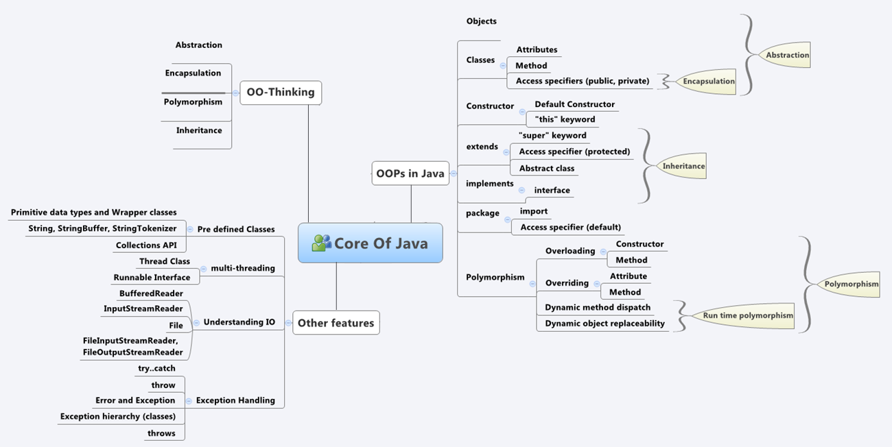
OO Thinking

Slide 4
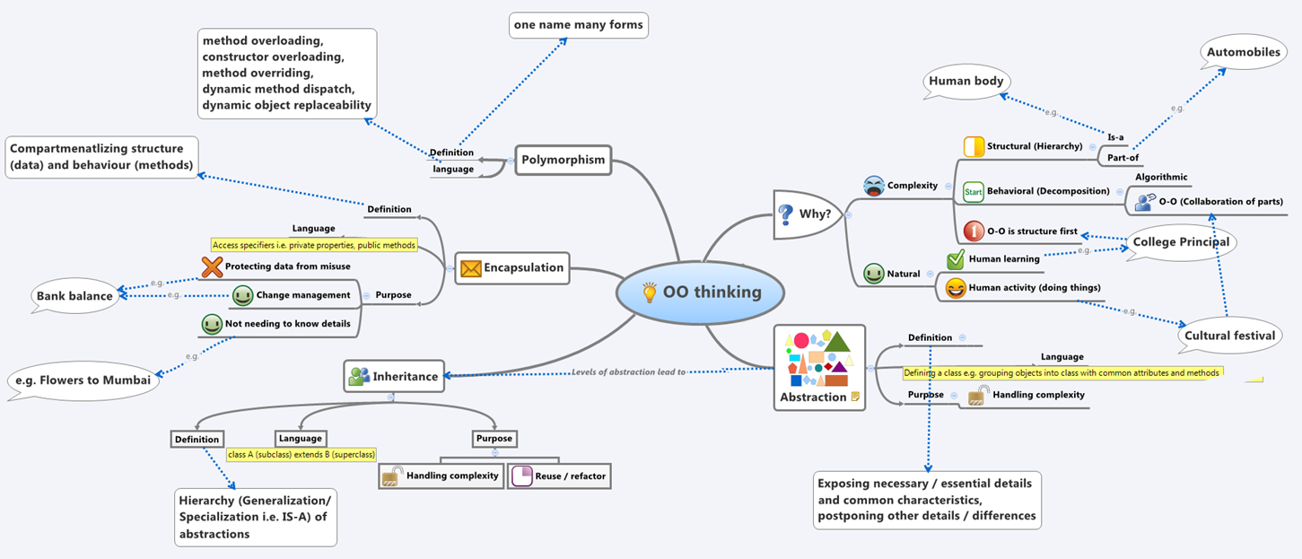
OO Thinking

Slide 5
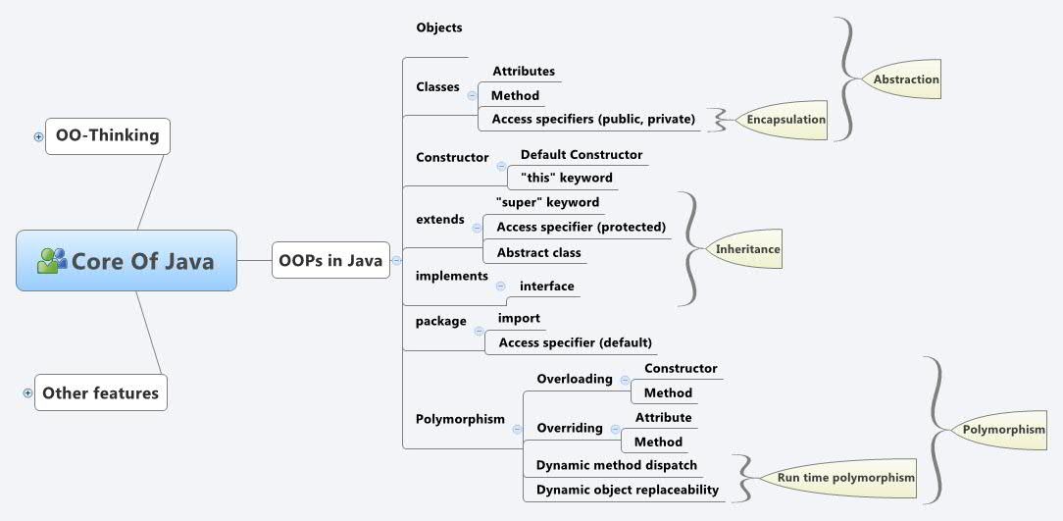
OO Thinking

Slide 6
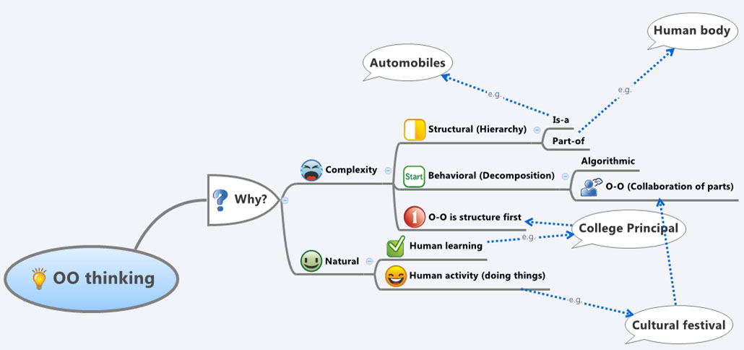
Why OO Thinking?

Slide 7
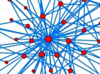
OO Thinking
Dealing with complexity
Complexity can be in structure as well as behavior.
The structure of complex systems is Hierarchic, - IS A hierarchy and part of hierarchy.
Behavioral complexity can be handled by collaboration of its parts.

Slide 8



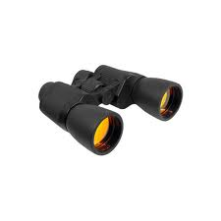







OO Thinking
OO Thinking
Structural Complexity
Explain what have you seen?
Observe the following image
Shapes
People
Things
Notes:
<< show the following image to the students for a flick of a second>>
<< ask the students what they have observed in the image >>
<< again show the image for a little longer and ask the students what they have observed >>
<< again show the image for a little more longer and ask the students what they have observed >>

Slide 9
OO Thinking
OO Thinking
Structural Complexity
Tell more about what you have seen?
Observe the image again
Triangles, Circles, Rectangles, Squares and Pentagons
Notes:
<< show the following image to the students for a flick of a second>>
<< ask the students what they have observed in the image >>
<< again show the image for a little longer and ask the students what they have observed >>
<< again show the image for a little more longer and ask the students what they have observed >>

Slide 10
OO Thinking
Structural Complexity
Tell every thing you have seen?
Observe the image again
Different Sizes, Different Colors
2 Triangles, 2 Circles,
2 Rectangles, 3 Squares and
2 Pentagons
Notes:
<< show the following image to the students for a flick of a second>>
<< ask the students what they have observed in the image >>
<< again show the image for a little longer and ask the students what they have observed >>
<< again show the image for a little more longer and ask the students what they have observed >>

Slide 11
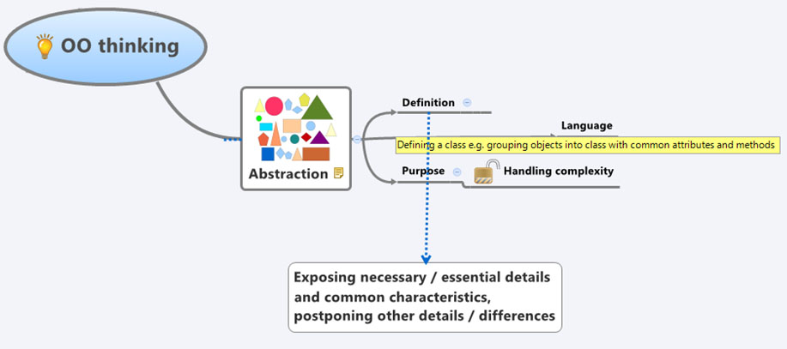
OO Thinking
OO Thinking
Abstraction

Slide 12

OO Thinking
Examples of Abstraction

Slide 13






OO Thinking
OO Thinking
Examples of Abstraction: Student
OBJECTS
ATTRIBUTE
BEHAVIOR
BEHAVIOR
Students | Student ID | Rules Book | Exam Process
 | 01
 | 02
 | 03
 | 04

Slide 14
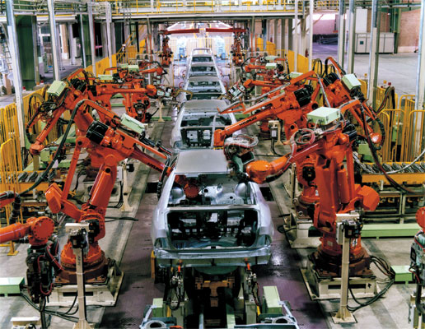
OO Thinking
OO Thinking
Examples of Abstraction: Manufacturing of Automobiles
Many Cars Same Process

Slide 15
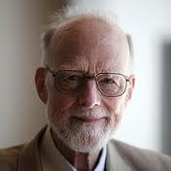

OO Thinking
Other definitions of Abstraction:
“Abstraction arises from a recognition of similarities between certain objects, situations, or processes in the real world, and the decision to concentrate upon those similarities and to ignore for the time being the differences.”
Tony Hoare
“An abstraction denotes the essential characteristics of an object that distinguish it from all other kinds of objects and thus provide crisply defined conceptual boundaries, relative to the perspective of the viewer.”
Grady Booch

Slide 16
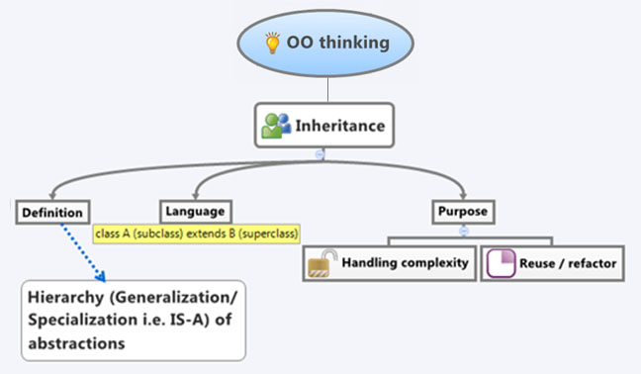
OO Thinking
OO Thinking
Inheritance

Slide 17
OO Thinking
IS-A Hierarchy
SHAPES

Slide 18




OO Thinking
OO Thinking
Inheritance Example: Doctor
D
CTOR
IS-A
IS-A
IS-A
Pediatrician
Gynecologist
Geriatrician

Slide 19

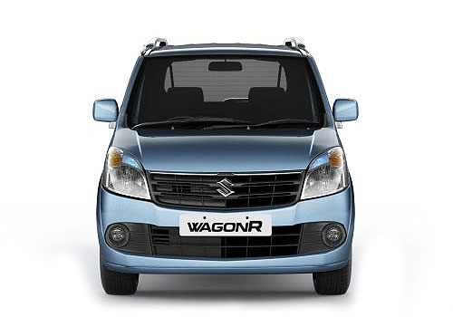
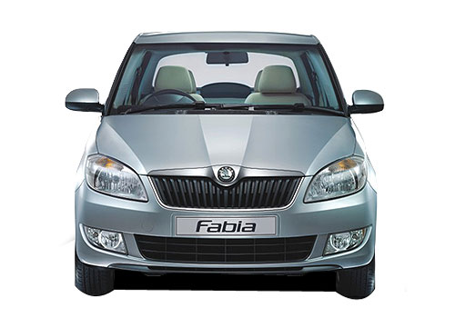
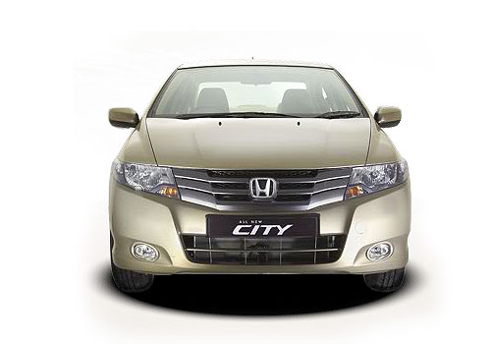
OO Thinking
OO Thinking
Inheritance Example: Car
CAR
IS-A
IS-A
IS-A

Slide 20




OO Thinking
Inheritance Example: Student
Same Rule Book
Same Exam Process
Student
IS-A
IS-A
IS-A
IS-A
Different Admission Processes
Convener Quota | Management Quota | Spot Admission | Lateral Entry
Student Type

Slide 21

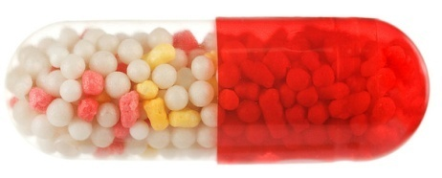
OO Thinking
OO Thinking
Encapsulation
Tablet
Capsule
Which one you prefer?
Prefer capsule to avoid bitter taste of medicine.

Slide 22
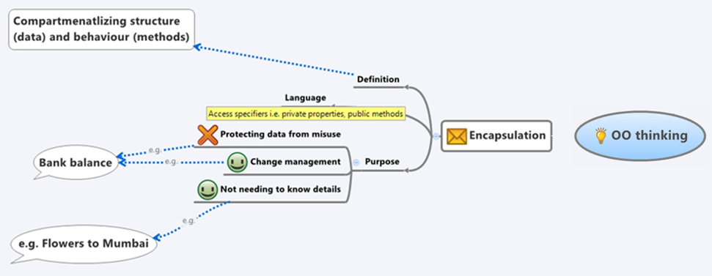
OO Thinking
OO Thinking
Encapsulation

Slide 23
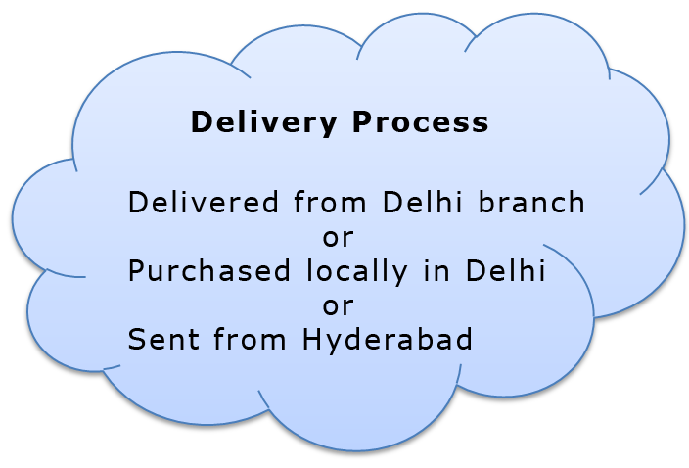
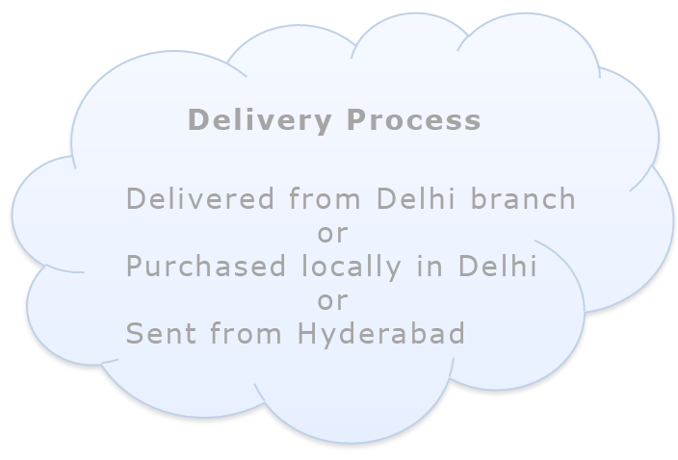


OO Thinking
Encapsulation Example: Bouquet to Delhi
No need to know details
Ordering a Bouquet online from Hyderabad
Bouquet delivered in Delhi

Slide 24
OO Thinking
OO Thinking
Encapsulation Example: Bank Account Balance
Transactions
Withdrawal New Bal = Current Bal – Txn Amt | DD Charges New Bal = Current Bal – Txn Amt
Bill Payments New Bal = Current Bal – Txn Amt | Cheque Payment New Bal = Current Bal – Txn Amt
ECS New Bal = Current Bal – Txn Amt | Service Charge New Bal = Current Bal – Txn Amt

Slide 25


OO Thinking
OO Thinking
Encapsulation Example: Bank Account Balance
Requirement Changed: Minimum Balance Required Rs 5000
Transactions
Withdrawal New Bal = Current Bal – Txn Amt if New Bal < 5000 Decline Txn | DD Charges New Bal = Current Bal – Txn Amt if New Bal < 5000 Decline Txn
Bill Payments New Bal = Current Bal – Txn Amt if New Bal < 5000 Decline Txn | Cheque Payment New Bal = Current Bal – Txn Amt if New Bal < 5000 Decline Txn
ECS New Bal = Current Bal – Txn Amt if New Bal < 5000 Decline Txn | Service Charge New Bal = Current Bal – Txn Amt
Forgot to change
Change Management: So Many Changes

Slide 26
OO Thinking
OO Thinking
Encapsulation Example: Bank Account Balance
New Bal = Current Bal – Txn Amt
reduceBalance ( Txn Amount )
Uses
Transactions
Withdrawal reduceBalance (Txn Amount ) | DD Charges reduceBalance (Txn Amount )
Bill Payments reduceBalance (Txn Amount ) | Cheque Payment reduceBalance (Txn Amount )
ECS reduceBalance (Txn Amount ) | Service Charge reduceBalance (Txn Amount )

Slide 27

OO Thinking
OO Thinking
Encapsulation Example: Bank Account Balance
Requirement Changed :Minimum Balance Required Rs 5000
New Bal = Current Bal – Txn Amt
New Bal = Current Bal – Txn Amt
if New Bal < 5000 Decline Txn
reduceBalance ( Txn Amount )
reduceBalance ( Txn Amount )
Transactions
Withdrawal reduceBalance (Txn Amount ) | DD Charges reduceBalance (Txn Amount )
Bill Payments reduceBalance (Txn Amount ) | Cheque Payment reduceBalance (Txn Amount )
ECS reduceBalance (Txn Amount ) | Service Charge reduceBalance (Txn Amount )
Unchanged

Slide 28
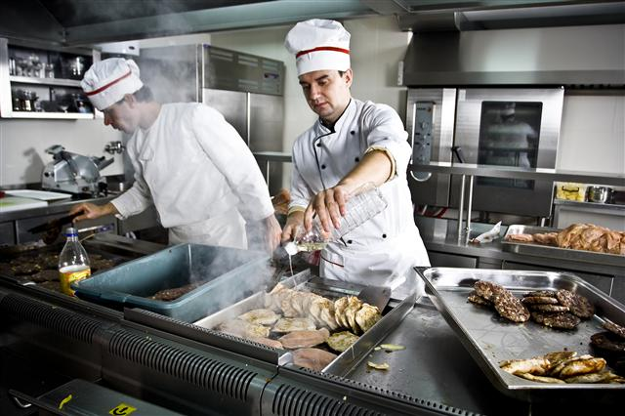
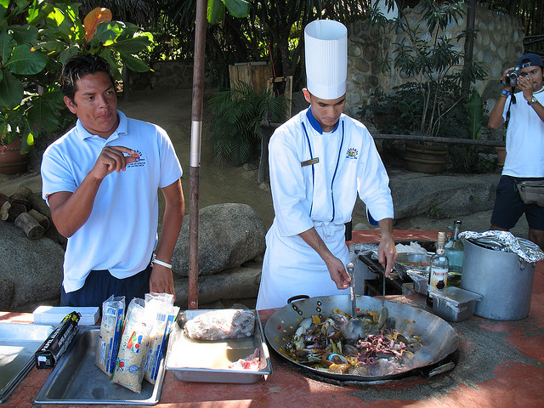
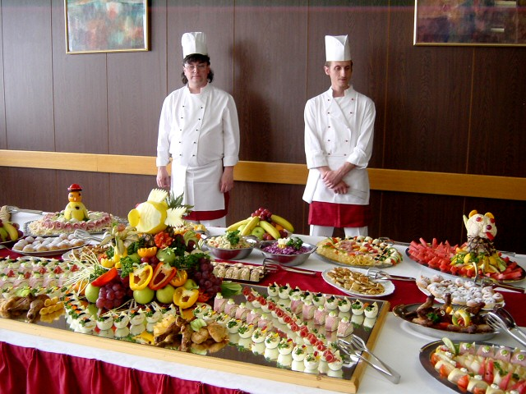
OO Thinking
OO Thinking
Encapsulation Example: Catering
No need to know details

Slide 29
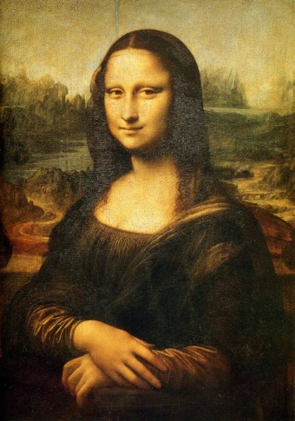
OO Thinking
Polymorphism

Slide 30
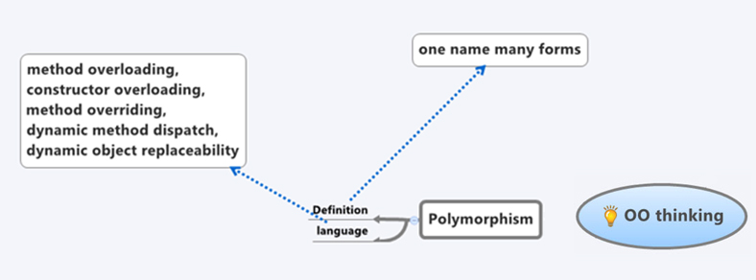
OO Thinking
OO Thinking
Polymorphism

